Slide 1
GROWTH

Slide 2
Growth (Spiritual)
Through Studying the Word… Study for God’s Approval (2Tim.2:15)
To Become Teachers (Heb.5:12-14)
Receive Word with Meekness (James1:21-25)
Grow in Knowledge (2Pet.3:18)
Instructed in Righteousness (2Tim.3:16-17)

Slide 3
Growth (Spiritual)
Through adding Christian Graces… add faith, virtue, knowledge… (2Pet.1:5-8)
Through Fervent, Regular Prayer (James1:5-6; 1John5:14; Mark11:24)
Through Working as a Christian
(2Tim.4:7-8; Eph.2:10)
Through Worshipping Acceptably (Heb.10:25; John4:23-24; Eph.5:19)

Slide 4
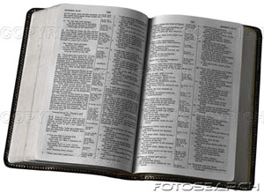
“Oh how I love your law! I meditate on it all day long.” Psa.119:97
“Your word is a lamp to my feet and a light for my path.” Psa.119:105

Slide 5
Spiritual Growth
resources
“…grOw in grace, and in the knowledge of our lord” (2Peter 3:18)

Slide 6
Gospel Broadcasting Network
How Shall They Hear?
“Preach the Gospel to every creature” is a charge current in every generation until the end of time. Admittedly, reaching every soul with the message of salvation is challenging, considering the world’s population of over six billion could double by the year 2040! Coupled with the fact that about a hundred precious souls are dying every minute, the problem the Lord’s people face in reaching a world rapidly rushing into eternity is obvious. However, since God desires that all men be saved and come to the knowledge of the truth, we must believe He has given His people the power and potential to solve the problem of reaching every soul with the truth.

Slide 7
"GOSPEL BROADCASTING NETWORK"
...a satellite network, broadcasting the truth and nothing but the truth, 24 hours a day, seven days a week... GBN is under the oversight of the Highland Church of Christ in Dalton, Georgia. The primary thrust of the network is:
To establish in viewers of all ages a strong belief in the existence of God through a heavy concentration of Christian evidences,
To establish in viewers the conviction that God has revealed Himself and His will to man through the Bible; and
To encourage the proper response to God’s Word—obedience to the plan of salvation and adherence to the New Testament pattern of worship, work, and Christian living.

Slide 8
"GOSPEL BROADCASTING NETWORK"
In many places brethren are threatened by false teaching. A saturation of sound Bible teaching via GBN may help strengthen them to withstand error and to stand for the truth. In areas where the church is practically nonexistent and brethren are striving to grow in the faith, GBN’s programming may be viewed, possibly videotaped, to edify these Christians and assist them in their evangelistic efforts.

Slide 9
In the late 1970s, there was a need to make available scripturally sound and scientifically accurate materials in apologetics among the churches of Christ. The idea for Apologetics Press was born—an idea that soon became a reality.
Currently, Dr. Dave Miller serves as the Executive Director. Dr. Miller, Kyle Butt, and Eric Lyons compose the fulltime professional writing staff, assisted by an auxiliary staff of scientists including Dr. Will Brooks, Dr. Jerry Fausz, Dr. Michael Houts, and Jeff Miller, as well as an office support staff that includes secretaries, production administrators, a Spanish translator, a graphics-design artist, and a scientific illustrator.

Slide 10
For more than twenty years Apologetics Press has published and distributed materials for self study, group study, or evangelistic purposes. Topics range from evidences supporting the Christian Faith to highly controversial areas that challenge that Faith.
Contents:
Reason & Revelation
Discovery
Other Materials

Slide 11
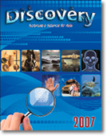

Slide 12
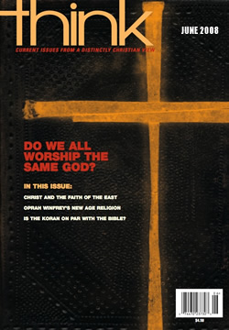
The founding purpose of Focus Press is to encourage men, women, and children to train their minds to meditate on that which is good. Our goal is to help individuals focus on matters of the present and eternity. We sincerely desire to promote spiritual development and strengthening of faith among Christians. May at least one soul who does not know of God’s eternal salvation, discover it. May someone whose heart is heavy recall a reason to have hope and rejoice in the Lord. May zeal for Christ and His church be rekindled and new levels of commitment and service be achieved; and, in all, may we serve humbly and faithfully – To God be the glory!

Slide 13
"We are committed to providing sound material that is appealing and challenging for today's youth. We hope this new magazine will not only help young people remain faithful but will also encourage them to take their light into the world. We hope your congregation will take advantage of this new resource for teens." –Brad Harrub and Jim Palmer, Publishers and Editorial Directors

Slide 14
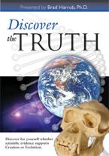

Slide 16
Audio Evangelism (AE) is a work of the church of Christ in Clinton, IL (www.theclintonchurchofchrist.org).
AE is an audio-focused Bible teaching tool with transcripts made available for those who desire such.
The AE site is divided into two primary sections: Daily Bread and Sound Words. Daily Bread is composed of devotionals (all under five minutes in duration). A new lesson is posted every weekday. Sound Words is a weekly feature of approximately fifteen minutes in length (posted every Saturday).
The aim for all devotionals and lessons is faithfulness to God's word, the Bible. The hope is that AE will be an effective tool for evangelism and edification, and that it will aid people in studying the Scriptures daily (Acts 17:11). Anyone with an email address may subscribe to AE for free via our subscriptions page, and email reminders will be sent to them daily or weekly (according to their preference).

Slide 17
September/October
Issue:
2,876,922 copies
1181 churches in 48 states and Australia, the Bahamas and Canada.
All time: 89,997,417 copies

Slide 18
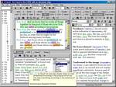
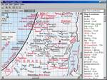
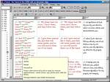
e-Sword is a fast and effective way to study the Bible. e-Sword is feature rich and user friendly with more capabilities than you would expect in a free software package. The fact that e-Sword is free is just one of the blessings and does not speak of the quality of the software.

Slide 19
Spiritual Growth
resources
“…grOw in grace, and in the knowledge of our lord” (2Peter 3:18)

